Slide 1
Mongo GeoJSON

Slide 2
JSON FILE
From CSV to JSON

Slide 3
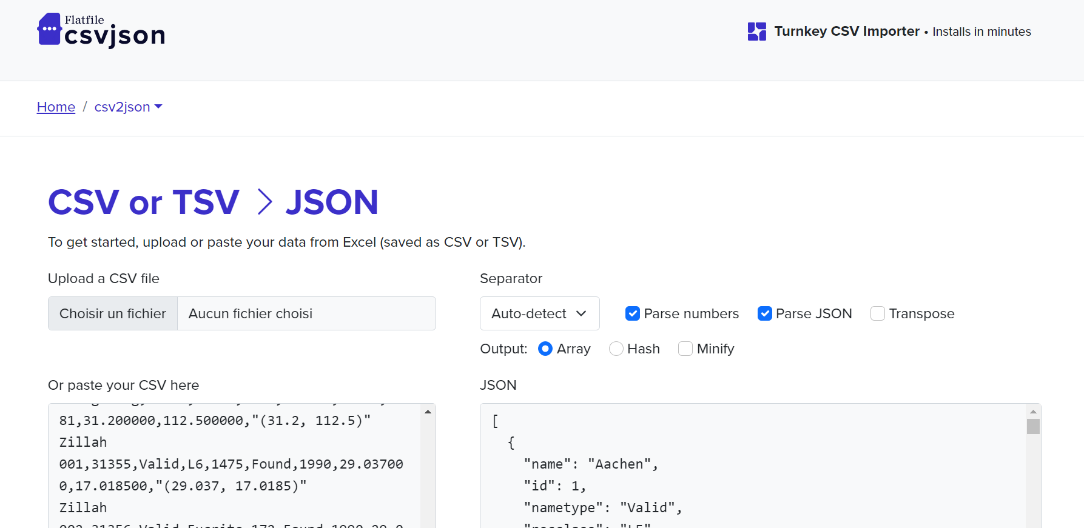

Slide 4
Mongo DB

Slide 5
QUERIES
From 45716 to 38401: {reclat: { $not: { $eq: "" } }, reclong: { $not: { $eq: "" } } }
From 38401 to 38331: nametype: « Valid »
Keeping fields id, name, year, reclat(latitude) and reclong(longitude)

Slide 6
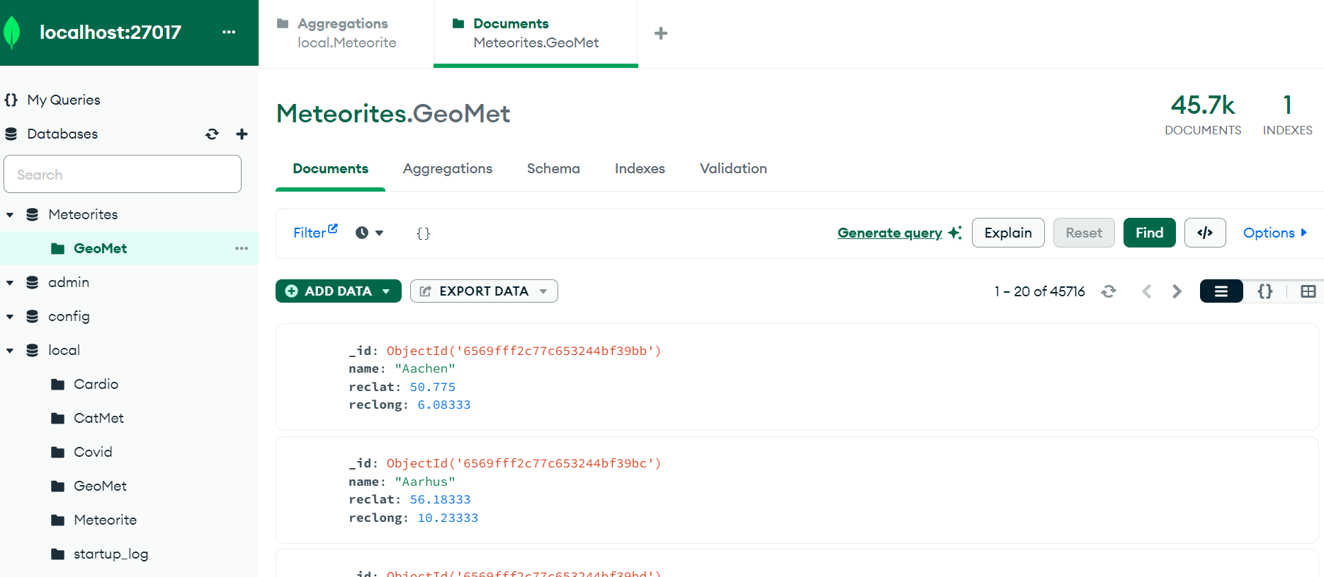
Starting with 45K OBSERVATIONS

Slide 7
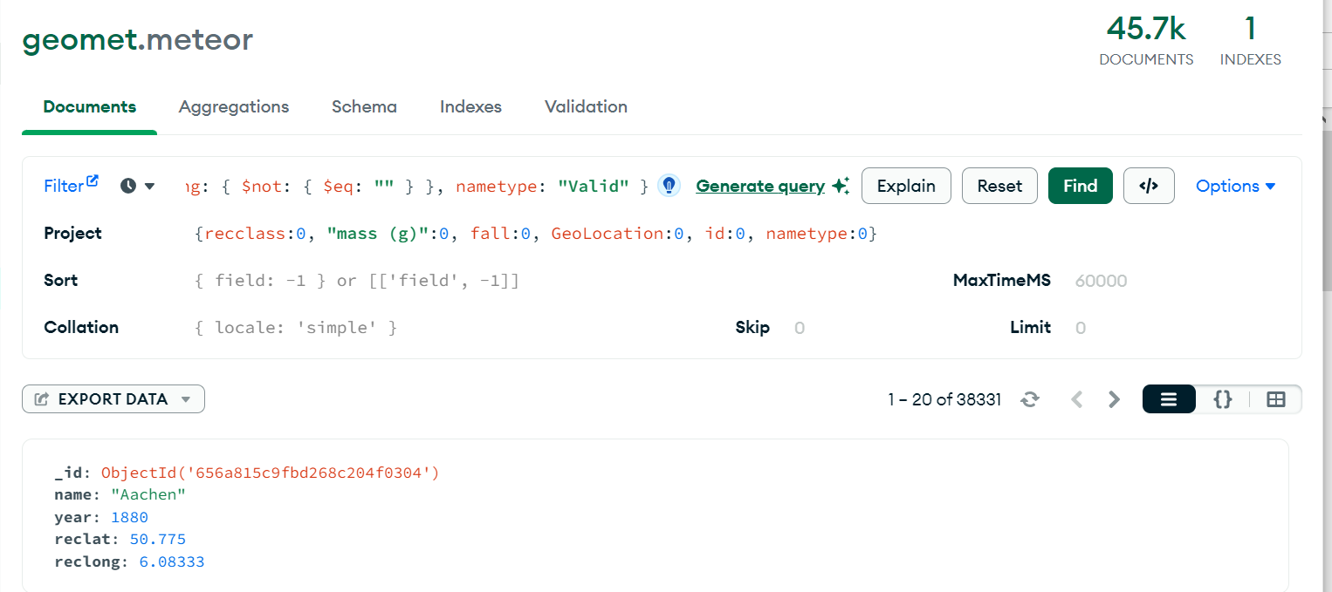
TAKING OUT NULL / SELECTING FIELDS

Slide 8
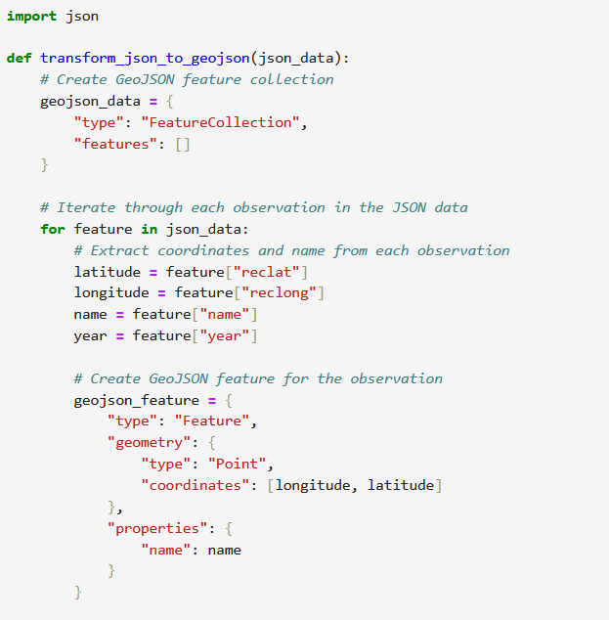
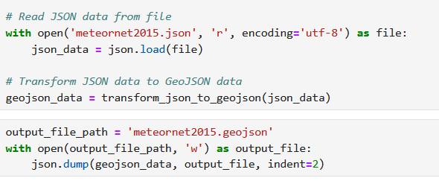
Python code to get GeoJSON data

Slide 9
From GeoJSON to MAPS

Slide 10
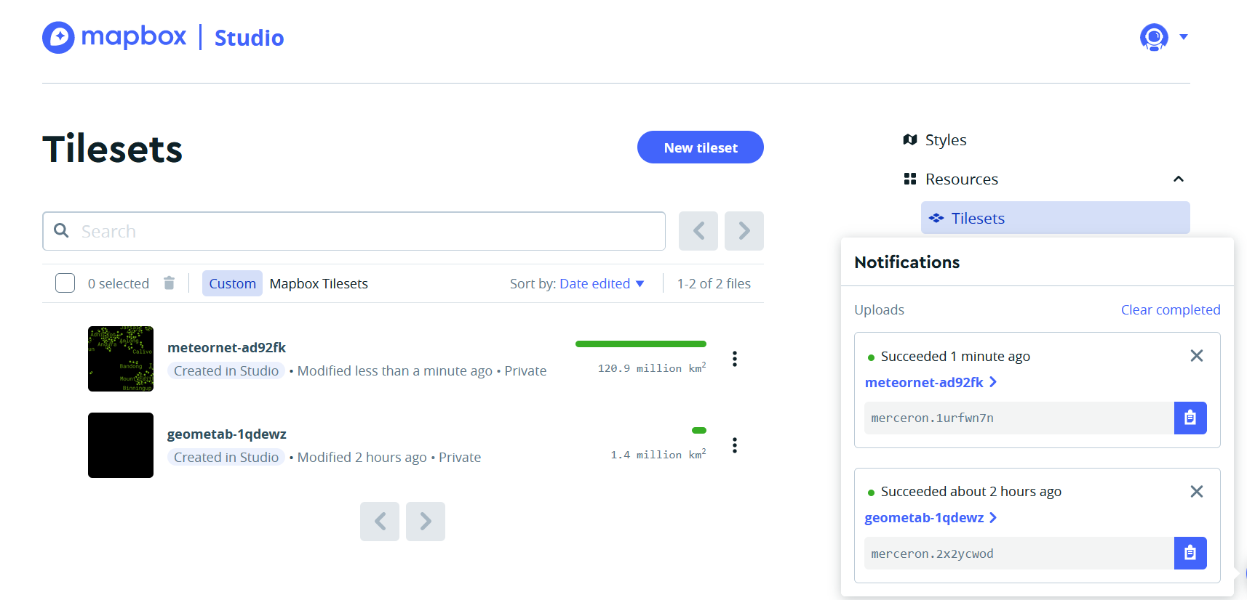

Slide 11
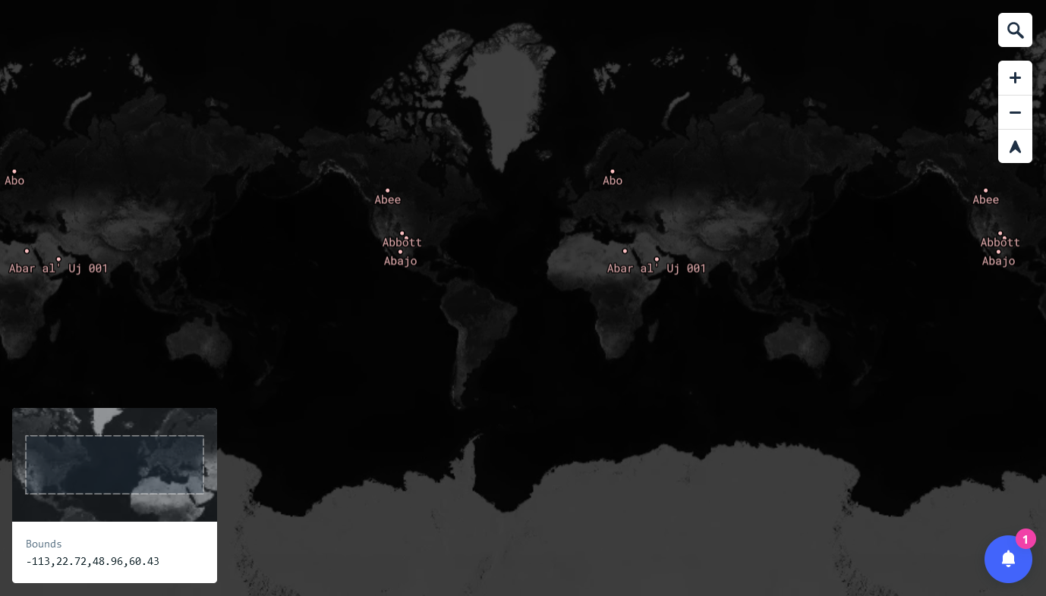
Intial test with a limited query (« ab* » names

Slide 12
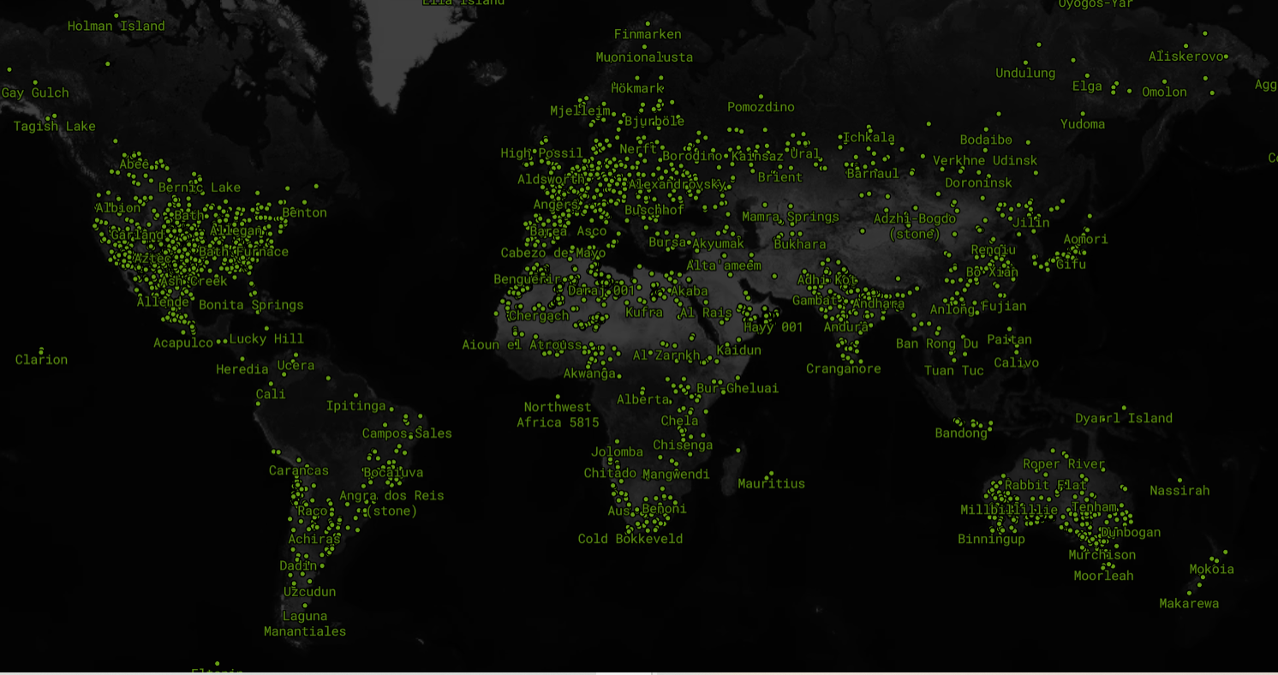

Slide 13
Selecting different timeframes

Slide 14
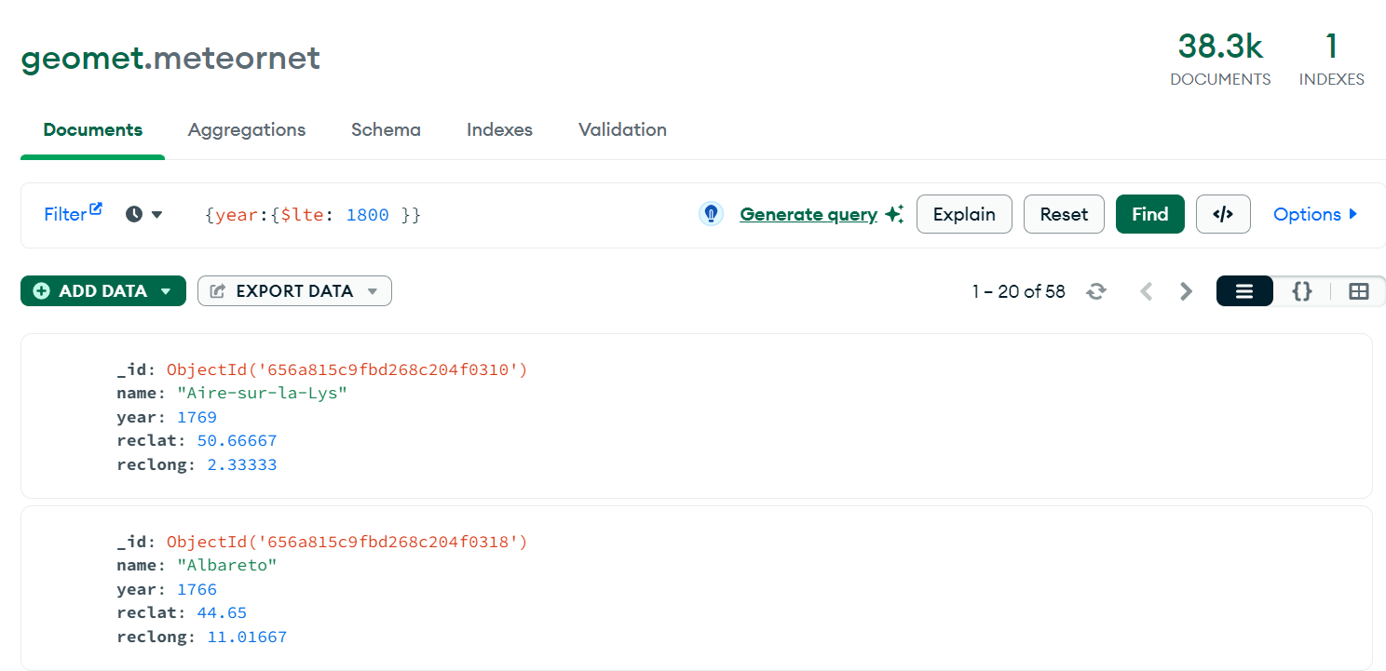

Slide 15


Slide 16
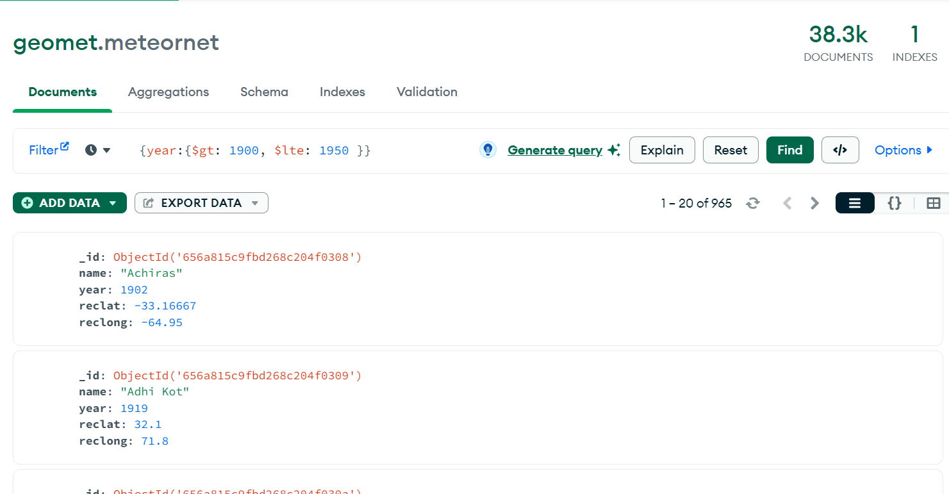

Slide 17
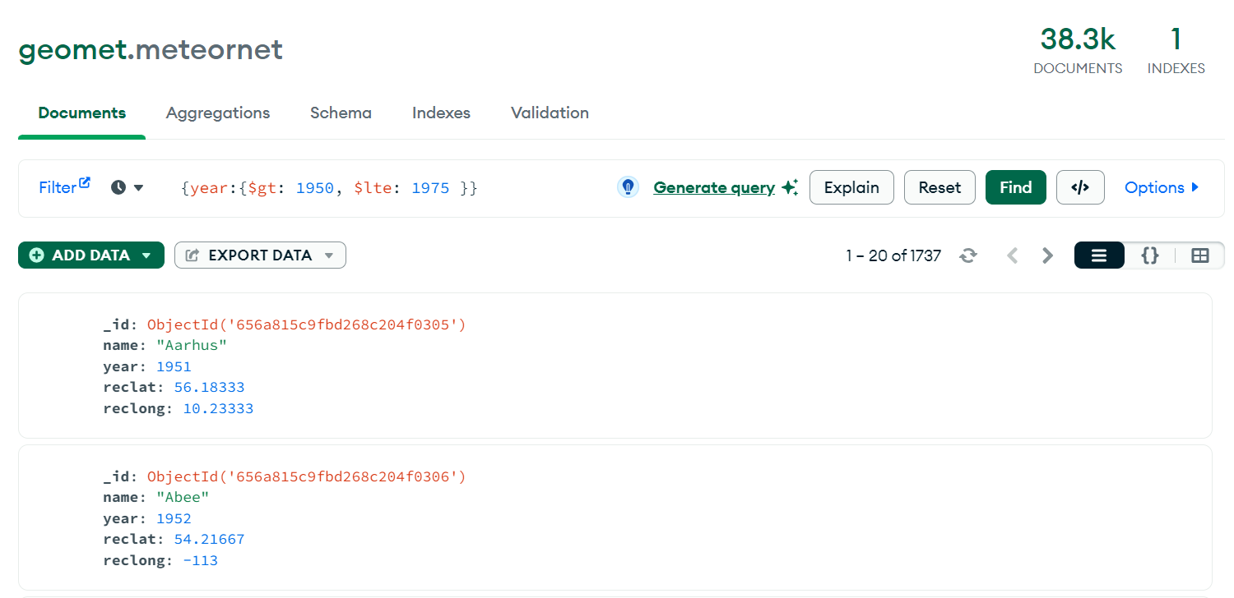

Slide 18
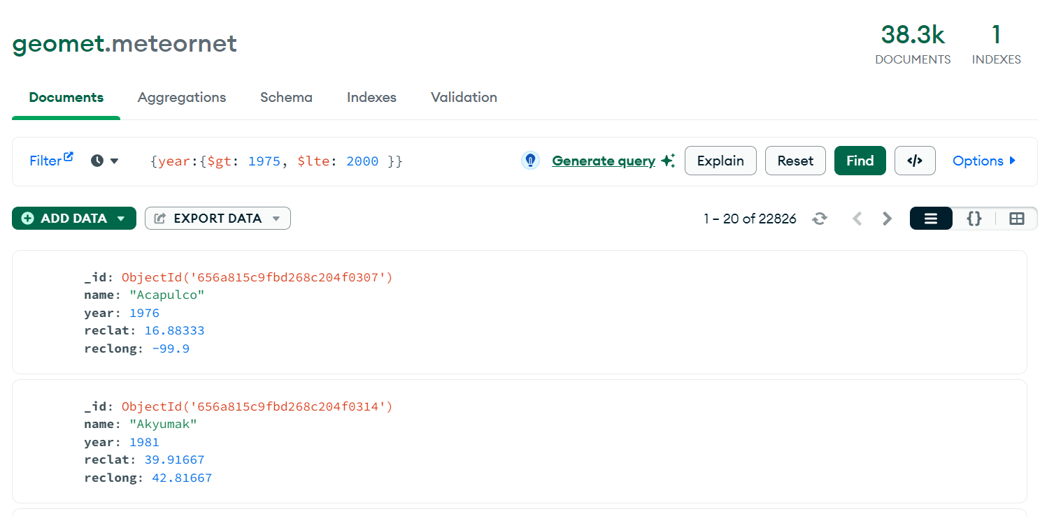

Slide 19
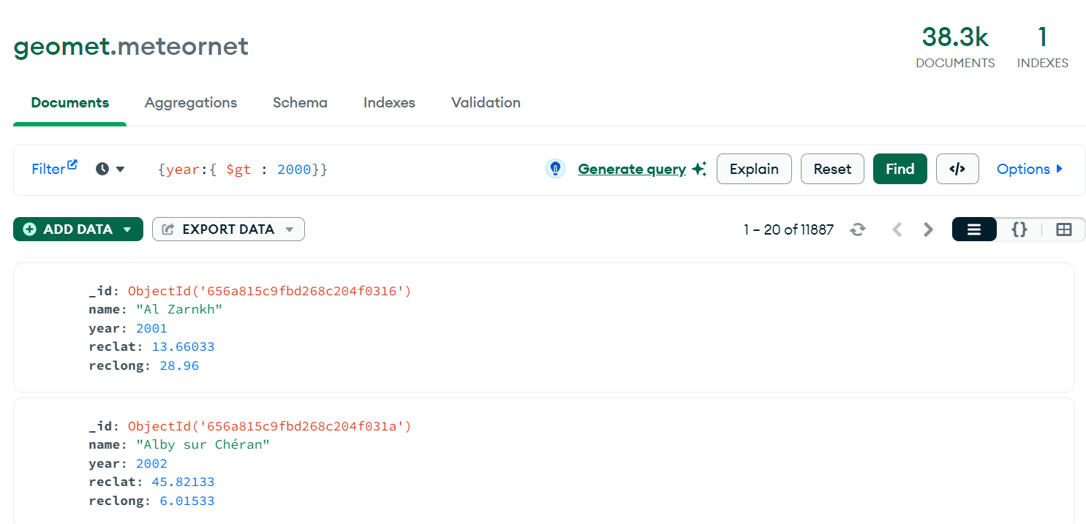

Slide 20
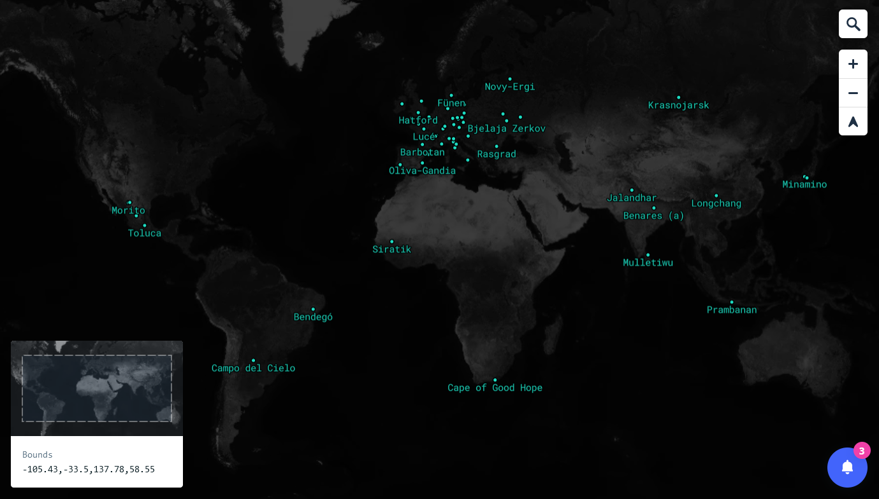
->1800
-> 1800

Slide 21
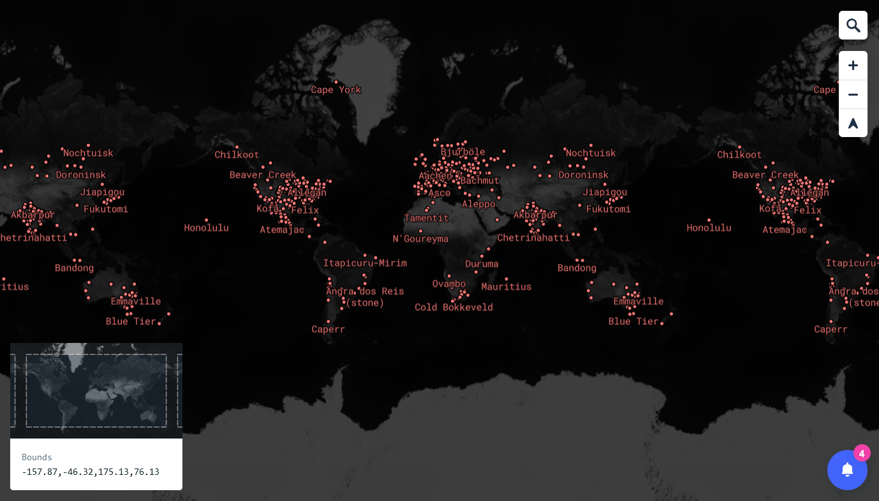
1800 - 1900
1800 - 1900

Slide 22
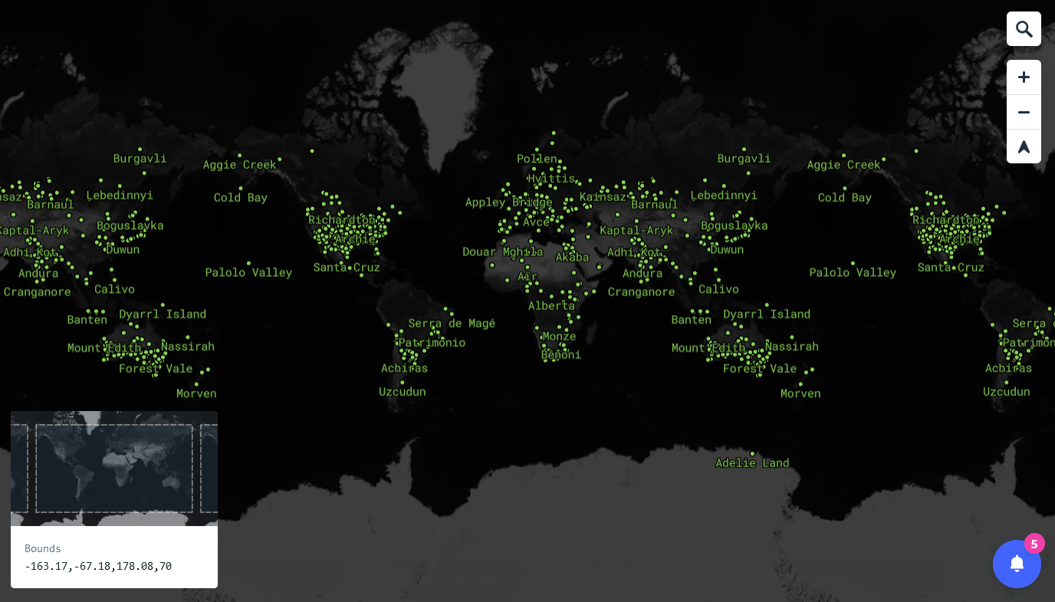
1900 - 1950
1900 - 1950

Slide 23
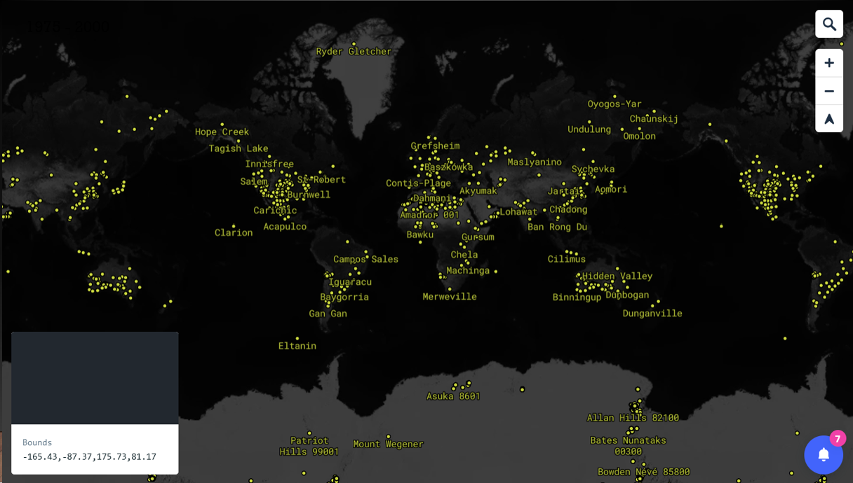
1950 - 1975

Slide 24
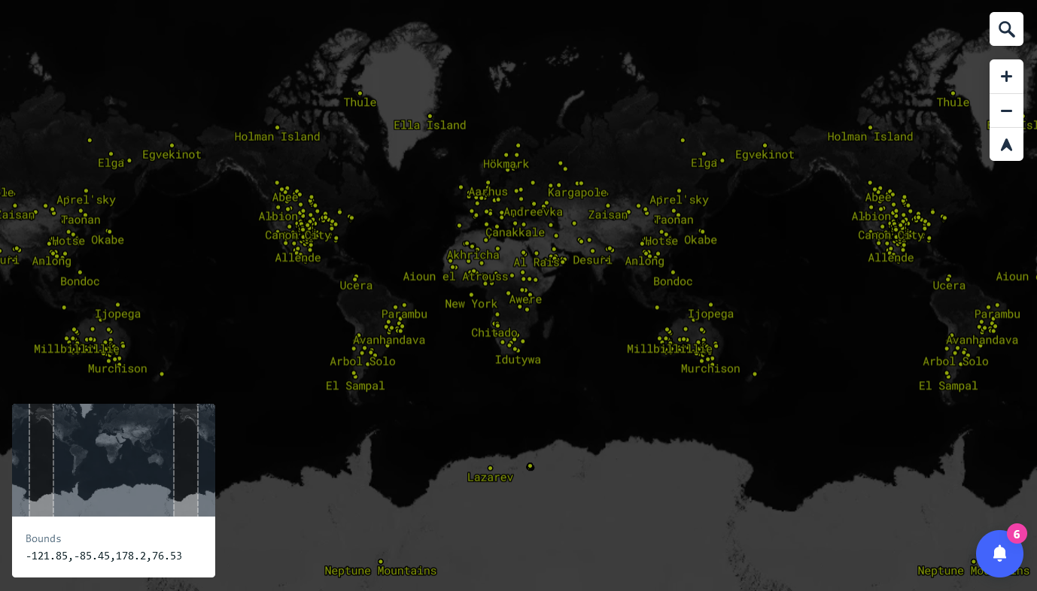
1950 - 1975
1975 - 2000

Slide 25
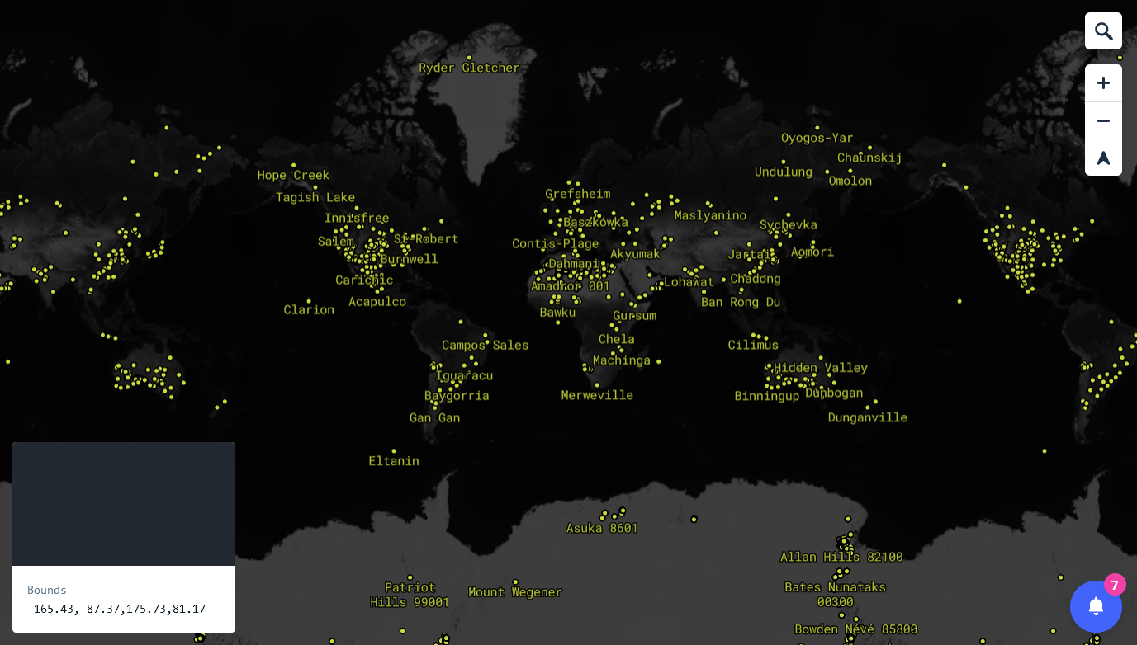
1975 - 2000
2000 - 2015

